Slide 1
PREP Planning
Humboldt State University
Joyce Lopes, Carol Lorentzen, Volga Koval, Randi Darnall Burke, Kate Stroup, Teal Sexton, Amber Blakeslee, Jacque Honda

Slide 2
PREP Planning
Agenda
Overview of PREP Planning
Resource request process
Next steps

Slide 3
What is PREP?
PREP: Program Review, Evaluation and Planning
Program Review
Ongoing assessment of campus programs
Annual review, establish trends, track progress, continuous improvement
Program review required for accreditation
Planning
Integrates program reviews into planning and budgeting processes
Aligns resource allocations with campus priorities

Slide 4
WASC Program Review Rubric
Criterion: Planning and Budgeting
Initial: No integration
Emerging: Attempted integration, but with limited success
Developed: General integration, but no formal process
Highly Developed: Systematic integration with formal action plans and mutually agreed upon commitments
http://wascsenior.org/files/Rubrics___combined.pdf

Slide 5
Planning: Focus on Assessment Cycle

Slide 6
PREP Planning at HSU
Build off of Program Review
Implement campus priorities
Implement WASC recommendations
Document campus planning efforts
Provide a process for requesting and allocating resources
Track resource allocations through completion to facilitate reporting and assessment

Slide 7
Goals and Objectives
Align resource allocations with campus priorities
Transparency
Accountability
Support evidence-based decision-making
Data repository for resource requests
Align department planning with campus level planning
Continuous improvement

Slide 8
PREP Planning Cycle
2. Request Resources
3. Review and Allocate Resources
4. Evaluate Resource Allocations
5. Use Results for Improvement
1. Establish Campus Priorities

Slide 9
Funding Framework and Process
Department Level Resource Requests
MBU Level Review and Approval
Division Level Review and Approval
University Level Review and Approval
Budget requests made through the PREP Planning process. Includes requests that cannot be met with existing departmental budget.
Includes departmental staff, faculty and/or OE expansions or reallocations. Granted by Dean/MBU Director/AVP.
Includes initiatives that involve one or more MBUs, pilot programs, division-wide initiatives, one-time augments to MBUs for specific items. Granted by the Provost or Division VP.
Includes division augment requests, capital planning items, cross-divisional projects, major University initiatives brought forward by the President and the VPs. Reviewed and approved by the URPC to be included in the annual budget recommendation to the President.
MBU: Major Budget Unit

Slide 10
Draft Timeline
 | Department | MBU | Division | URPC
October - November | X
December |  | X
January - February |  |  | X
March |  |  |  | X

Slide 11
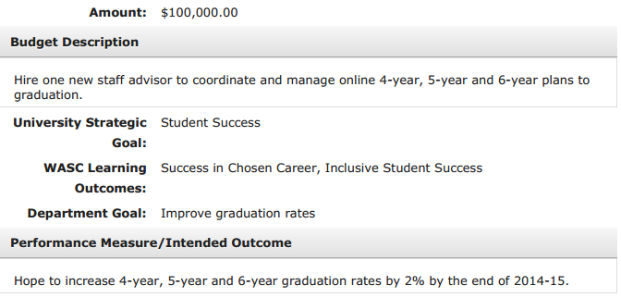
Department: Create Resource Requests
DEPARTMENT ACTION
Year 1
1. Update Program Review
2. Enter resource requests
Year 2 and after
1. Review and report on prior resource allocations
2. Update Program Review
3. Enter new resource requests

Slide 12
MBU Level Review and Approval Process
Step 1: Review list of resource requests
Step 2: Make decision on each resource request
Approve and fund request within MBU
Review – request funding from Division
Reject request

Slide 13
Division Level Review and Approval Process
Step 1: Review list of resource requests
Step 2: Make decision on each resource request
Approve and fund request within Division
Review – request funding from University
Reject request

Slide 14
University Level Approval - URPC
Finalized list of resource requests submitted to URPC

Slide 15
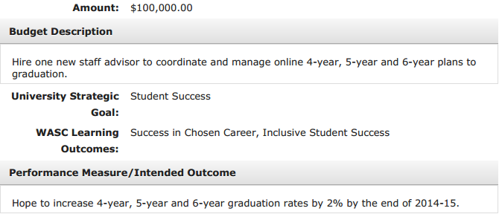
Reporting and Assessment
Track resource allocations to facilitate reporting and assessment. Reports provided to URPC annually.

Slide 16
Results to URPC

Slide 17
Next Steps
Process Development – gather feedback, improve process
Review process with Vice Presidents
Review process with budget analysts and other campus user groups
URPC: Develop evaluation criteria, guidelines for funding framework
Implementation
Testing and report development
Work with MarCom on communication plan
Develop training and user guides
Training rollout to managers/chairs, budget analysts, user groups
Roll out Fall 2013

