Slide 1
Why Strategic Budgeting?

Slide 2
Good to Great
Focus on Priorities
Build on our Uniqueness
Elevate our Success
Be Sustainable

Slide 3
2015-2020 Strategic Plan Goals
GOAL 1: Prepare students to be socially and environmentally responsible leaders in a diverse and globalized world
GOAL 2: Foster meaningful relationships across differences, including diverse cultural communities, identities, and competencies
GOAL 3: Strengthen partnership with local communities
GOAL 4: Serve as effective stewards of the natural and built environment and the University’s financial resources with a focus on sustainability

Slide 4
CSU Targets

Slide 5
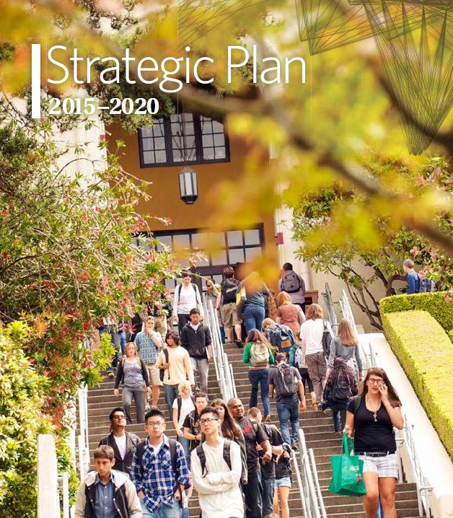
Linking Planning and Budgeting
In the absence of a plan – the budget is the plan
If a plan exists and it is not closely linked to the budget – the budget is still the plan
Therefore, if a plan is to be implemented, there must be a strong linkage between the plan and the budget

Slide 6
Linking Planning and Budgeting...
…Is so difficult because:
Planning is typically conducted at the strategic level
Budgeting is typically focused at the operational level
We need to develop an approach to strategic budgeting.

Slide 7
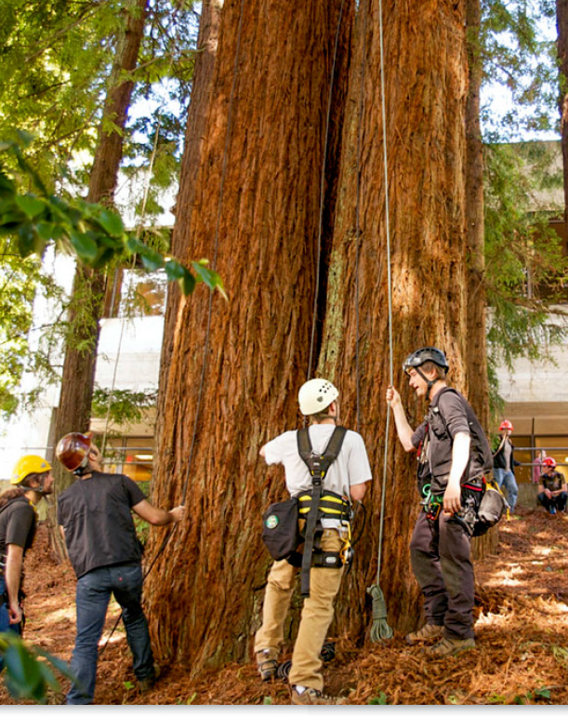
Decision-making
URPC needs to be focused here
Strategic decisions focus on:
Creation and maintenance of institutional capacity
Operational decisions focus on:
Utilization of that capacity in ways designed to accomplish specified purposes

Slide 8
The Focus of Attention
President
VPs & Senate Chair
Strategic Planning
Committees/Groups
Curriculum
Personnel
Operational Issues
Facilities
X
URPC
URPC
Students
Strategic Issues
Enrollment
Technology
Departments/Faculty

Slide 9
Role of the URPC

Slide 10
President’s Charge
Develop a strategic budgeting approach that aligns resource allocations with strategic planning by the end of the 2015-16 academic year.
A set of guiding principles for strategic budgeting, including definitions and guidelines for budget categories;
Proposals for appropriate policies to support strategic budgeting;
A recommended framework for evaluating existing base budgets
Recommended processes that integrate institutional data and assessment with resource requests; and
A revised proposal for a reserve policy.

Slide 11
Strategic Budget Categories
Investment in Strategic Planning Priorities (Dennis, 2%)
Innovation, experimentation, rewards, incentives
Continuing and Sustaining Assets
Facilities/Maintenance/Depreciation (Dennis, 2% CRV)
Maintain/Refresh equipment including IT
Maintain/refresh collections, including Library
Maintain/improve personnel (faculty/staff)
Maintain/improve programs
Maintain/improve students
Maintain/improve brand
Consumables
Contingency/emergencies (URPC = 4%)
Reserves (Dennis, 10%)

Slide 12
Strategic Budget Gap

Slide 13
How do we do it?

Slide 14
Next Steps
Develop guiding principles
URPC principles from last spring
Dennis’ strategic budgeting principles
Principles from other institutions
Define budget categories
Determine budget category percentages
Continue to make forward momentum

